Slide 1
2ECOE76 MATLAB for Engineers Lecture 5
Prepared by
-Twinkle Bhavsar

Slide 2
Loops are MATLAB constructs that permit us to execute a sequence of statements more than once.
Two basic forms
“While” loops | “For” loops
The code is repeated an indefinite number of times until some user-specified condition is satisfied. | The code is repeated a specified number of times, and the number of repetitions is known before the loops starts.

Slide 3

“While” loop
while expression produces a logical value
...
... Code block
...
end
true | false
If the expression is true, the code block will be executed, and will be repeated until the expression becomes false. | When control returns to the while statement and the expression is false, the program will execute the first statement after the end.

Slide 4

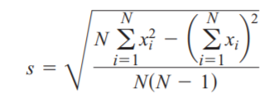
Example: The average or arithmetic mean of a set of numbers is defined as
Where, xi is sample i out of N samples.
The standard deviation of a set of numbers is defined as
Write a MATLAB program that reads in a set of measurements and calculates the mean and the standard deviation of the input data set.

Slide 5
%MATLAB Code:
% Initialize sums
n = 0; sum_x = 0; sum_x2 = 0;
% Read in first value
x = input('Enter first value: ‘);
% While Loop to read input values.
while x >= 0
% Accumulate sums.
n = n + 1;
sum_x = sum_x + x;
sum_x2 = sum_x2 + x^2;
% Read in next value
x = input('Enter next value: ‘);
end

Slide 6
% Calculate the mean and standard deviation
x_bar = sum_x / n;
std_dev = sqrt( (n * sum_x2 - sum_x^2) / (n * (n-1)) );
% Tell user.
fprintf('The mean of this data set is: %f\n', x_bar);
fprintf('The standard deviation is: %f\n', std_dev);
fprintf('The number of data points is: %f\n', n);

Slide 7
Output:
Enter first value:
The mean of this data set is: NaN The standard deviation is: NaN The number of data points is: 0.000000
If we enter either no numbers or only one number, then we will be dividing by zero in the foregoing equations! The division-by-zero error will cause divide-by-zero warnings to be printed, and the output values will be NaN. We need to modify the program to detect this problem, tell the user what the problem is, and stop gracefully.

Slide 8
%Modified Program:
% Initialize sums.
n = 0;
sum_x = 0;
sum_x2 = 0;
% Read in first value
x = input('Enter first value: ');
% While Loop to read input values.
while x >= 0
% Accumulate sums.
n = n + 1;
sum_x = sum_x + x;
sum_x2 = sum_x2 + x^2;
% Read in next value
x = input('Enter next value: ');
end

Slide 9
% Check to see if we have enough input data.
if n < 2 % Insufficient information
disp('At least 2 values must be entered!');
else % There is enough information, so
% calculate the mean and standard deviation
x_bar = sum_x / n;
std_dev = sqrt( (n * sum_x2 - sum_x^2) / (n * (n-1)) );
% Tell user.
fprintf('The mean of this data set is: %f\n', x_bar);
fprintf('The standard deviation is: %f\n', std_dev);
fprintf('The number of data points is: %f\n', n);
end

Slide 10
“For” loop
for index= expression Loop control expression
...
... Body
...
end
results in
Loop variable
An array

Slide 11
Example 1: Use a for loop to calculate the factorial function. The factorial function is defined as
N! = 1 for N = 0
N! = N * (N-1) * (N-2) * ... * 3 * 2 * 1 for N > 0
MATLAB code:
n_factorial = 1;
for ii = 1:5
n_factorial = n_factorial * ii
End
Output:
n_factorial=120

Slide 12
Example 2:The day of year is the number of days (including the current day) that have elapsed since the beginning of a given year. It is a number in the range 1 to 365 for ordinary years, and 1 to 366 for leap years. Write a MATLAB program that accepts a day, month, and year, and calculates the day of year corresponding to that date.

Slide 13
Example 3:
for ii = [5 9 7]
Statement 1
...
Statement n
End
Here, the control expression is an explicitly written 1 x 3 array, so statements 1
through n will be executed three times with the loop index set to 5 the first time,
9 the second time, and 7 the final time. The loop index ii is still set to 7 after the
loop finishes executing.

Slide 14
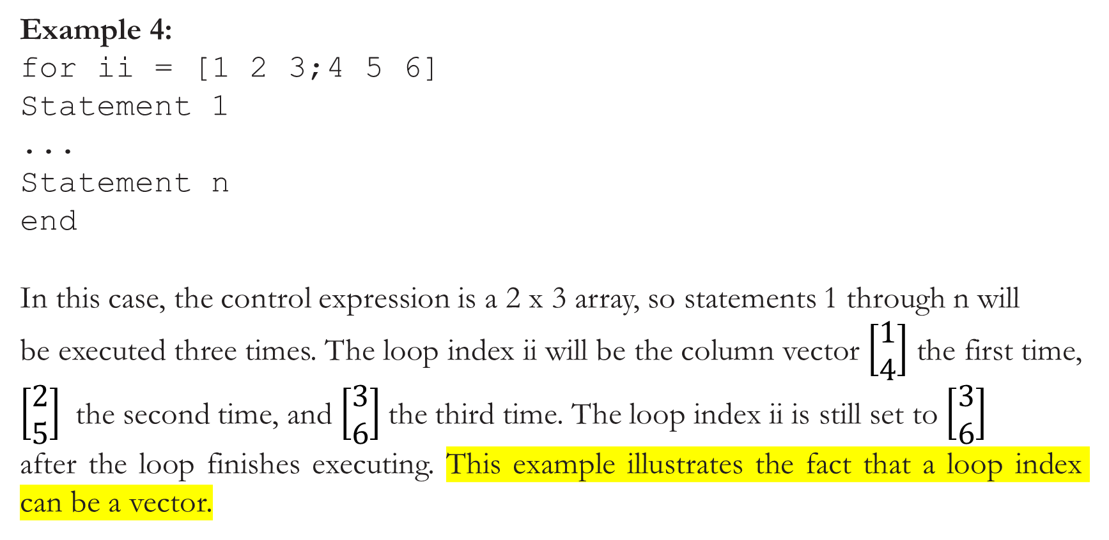
Example 4:
for ii = [1 2 3;4 5 6]
Statement 1
...
Statement n
end
In this case, the control expression is a 2 x 3 array, so statements 1 through n will
be executed three times. The loop index ii will be the column vector $\left[\begin{aligned}1 \\ 4\end{aligned}\right]$ the first time, $\left[\begin{aligned}2 \\ 5\end{aligned}\right]$ the second time, and $\left[\begin{aligned}3 \\ 6\end{aligned}\right]$the third time. The loop index ii is still set to $\left[\begin{aligned}3 \\ 6\end{aligned}\right]$
after the loop finishes executing. This example illustrates the fact that a loop index can be a vector.

Slide 15
Let’s compare the execution speeds of loops and vectors

Slide 16
% 1) Perform calculation with an uninitialized array "square". This calculation is done only once because it is so slow.
Program:
maxcount = 1; % Number of repetitions
tic; % Start timer
for jj = 1:maxcount
clear square % Clear output array
for ii = 1:10000
square(ii) = ii^2; % Calculate square
end
end
average1 = (toc)/maxcount
Output:
average1 = 0.0185

Slide 17
% 2) Perform calculation with a pre-allocated array "square", calling an external function to square the number. This calculation is averaged over 10 loops.
Program:
maxcount = 10; % Number of repetitions
tic; % Start timer
for jj = 1:maxcount
clear square % Clear output array
square = zeros(1,10000); % Pre-initialize array
for ii = 1:10000
square(ii) = sqr(ii); % Calculate square
end
end
average2 = (toc)/maxcount % Calculate average time
Output:
average2 = 0.0012

Slide 18
% 3) Perform calculation with a pre-allocated array "square". This calculation is averaged over 100 loops.
Program:
maxcount = 100; % Number of repetitions
tic; % Start timer
for jj = 1:maxcount
clear square % Clear output array
square = zeros(1,10000); % Pre-initialize array
for ii = 1:10000
square(ii) = ii^2; % Calculate square
end
end
average3 = (toc)/maxcount % Calculate average time
Output:
average3 = 2.2435e-04

Slide 19
% 4) Perform calculation with vectors. This calculation averaged over 1000 executions.
Program:
maxcount = 1000; % Number of repetitions
tic; % Start timer
for jj = 1:maxcount
clear square % Clear output array
ii = 1:10000; % Set up vector
square = ii.^2; % Calculate square
end
average4 = (toc)/maxcount; % Calculate average time
Output:
average4 = 4.2506e-05

Slide 20
% Display results
fprintf('Loop / uninitialized array = %8.4f\n', average1);
fprintf('Loop / initialized array = %8.4f\n', average2);
fprintf('Loop / initialized array = %8.4f\n', average3);
fprintf('Vectorized = %8.4f\n', average4);
Output:
Loop / uninitialized array = 0.0185 Loop / initialized array = 0.0012 Loop / initialized array = 0.0002 Vectorized = 0.0000

Slide 21
The loop in (1) and the loop in (2) were very slow compared with the loop in (3) or the vectorized loop (4). The vectorized loop was the fastest way to perform the calculation.

Slide 22
The break and continue Statements:
There are two additional statements that can be used to control the operation of while loops and for loops:
break | continue
It terminates the execution of a loop and passes control to the next statement after the end of the loop | It terminates the current pass through the loop and returns control to the top of the loop.
The break and continue statements work with both while loops and for loops.

Slide 23
Example of “break” statement:
Program:
for ii = 1:5
if ii == 3;
break;
end
fprintf('ii = %d\n',ii);
end
disp(['End of loop!']);
Output:
ii = 1
ii = 2
End of loop!

Slide 24
Example of “continue” statement:
Program:
for ii = 1:5
if ii == 3;
continue;
end
fprintf('ii = %d\n',ii);
end
disp(['End of loop!']);
Output:
ii = 1
ii = 2
ii = 4
ii = 5
End of loop!

Slide 25
Nesting Loops
It is possible for one loop to be completely inside another loop. If one loop is completely inside another one, the two loops are called nested loops.
Example 1:
for ii = 1:3
for jj = 1:3
product = ii * jj;
fprintf('%d * %d = %d\n',ii,jj,product);
end
end
Output:
1 * 1 = 1
1 * 2 = 2
1 * 3 = 3
2 * 1 = 2
2 * 2 = 4
2 * 3 = 6
3 * 1 = 3
3 * 2 = 6
3 * 3 = 9

Slide 26
Example 2:
for ii = 1:3
for jj = 1:3
if jj == 3;
break;
end
product = ii * jj;
fprintf('%d * %d = %d\n',ii,jj,product);
end
fprintf('End of inner loop\n');
end
fprintf('End of outer loop\n');
Output:
1 * 1 = 1
1 * 2 = 2
End of inner loop
2 * 1 = 2
2 * 2 = 4
End of inner loop
3 * 1 = 3
3 * 2 = 6
End of inner loop
End of outer loop

Slide 27
Explanation of Example 2:
If the inner loop counter jj is equal to 3, then the break statement will be executed. This will cause the program to exit the innermost loop. The program will print out “End of inner loop,” the index of the outer loop will be increased by 1, and execution of the innermost loop will start over.

Slide 28
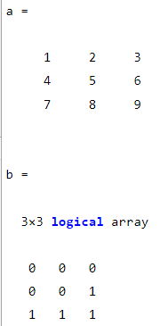
Logical Arrays and Vectorization
Consider the following statements:
a = [1 2 3; 4 5 6; 7 8 9];
b = a > 5;
Output

Slide 29
How to use it for performing an operation on a subset of an array without needing loops and branches?
Program:
a = [1 2 3; 4 5 6; 7 8 9];
b = a > 5;
a(b) = sqrt(a(b))
Output:
a =
1.0000 2.0000 3.0000
4.0000 5.0000 2.4495
2.6458 2.8284 3.0000
Logical arrays have a very important special property—they can serve as a mask for arithmetic operations.
fast and very clever way

Slide 30
Loop approach:
a = [1 2 3; 4 5 6; 7 8 9];
for ii = 1:size(a,1)
for jj = 1:size(a,2)
if a(ii,jj) > 5
a(ii,jj) = sqrt(a(ii,jj));
end
end
end
Vectorized approach:
a = [1 2 3; 4 5 6; 7 8 9];
b = a > 5;
a(b) = sqrt(a(b));
Output:
1.0000 2.0000 3.0000 4.0000 5.0000 2.4495 2.6458 2.8284 3.0000

Slide 31
Creating the Equivalent of if /else Constructs with Logical Arrays
Suppose, we wanted to take the square root of any elements in a two-dimensional array whose value is greater than 5, and to square the remaining elements in the array.
Loop approach:
for ii = 1:size(a,1)
for jj = 1:size(a,2)
if a(ii,jj) > 5
a(ii,jj) = sqrt(a(ii,jj));
else
a(ii,jj) = a(ii,jj)^2;
end
end
end
Vectorized approach:
b = a > 5;
a(b) = sqrt(a(b));
a(~b) = a(~b).^2;
It is possible to apply a different set of operations to the unselected elements of the array by simply adding the not operator (~) to the logical mask.

Slide 32
Quiz
Examine the following for loops and determine how many times
each loop will be executed.
for index = 7:10
for jj = 7:-1:10
for index = 1:10:10
for ii = -10:3:-7
for kk = [0 5 ; 3 3]
Ans1: 4
Ans2: 0
Ans3: 1
Ans4: 2
Ans5: 2
clc;clear all;
c=0;
for index = [0 5;3 3]
x=index;
c=c+1
end

Slide 33
Examine the following loops and determine the value in ires at the end of each of the loops.
6. ires = 0;
for index = 1:10
ires = ires + 1;
end
7. ires = 0;
for index = 1:10
ires = ires + index;
end
8. ires = 0;
for index1 = 1:10
for index2 = index1:10
if index2 == 6
break;
end
ires = ires + 1;
end
end
10
25
55

Slide 34
9. ires = 0;
for index1 = 1:10
for index2 = index1:10
if index2 == 6
continue;
end
ires = ires + 1;
end
end
49

Slide 35
The MATLAB Profiler
MATLAB(Offline) includes a profiler, which can be used to identify the parts of a program that consume the most execution time. The profiler can identify “hot spots” where optimizing the code will result in major increases in speed.

Slide 36
The MATLAB profiler is started by selecting the “Tools/Open Profiler” option on the Edit/Debug Window. A Profiler Window opens, with a field containing the name of the program to profile and a pushbutton to start the profile process running.

Slide 37
The profiler has a box in which to type the name of the program to execute, and a pushbutton to start profiling.

Slide 38
After the profiler runs, a Profile Summary is displayed, showing how much time is spent in each function being profiled.

Slide 39
Clicking on any profiled function brings up a more detailed display, showing exactly how much time was spent on each line when that function was executed.

Slide 40
With this information, the programmer can identify the slow portions of the code and work to speed them up with vectorization and similar techniques. Normally, the profiler should be run after a program is working properly. It is a waste of time to profile a program before it is working.

Slide 41
Physics—The Flight of a Ball
If we assume negligible air friction and ignore the curvature of the Earth, a ball that is thrown into the air from any point on the Earth’s surface will follow a parabolic flight path (see Figure a). The height of the ball at any time t after it is thrown is given by
Where,y0 is the initial height of the object above the ground, vy0 is the initial vertical
velocity of the object, and g is the acceleration due to the Earth’s gravity. The horizontal distance (range) traveled by the ball as a function of time after it is thrown is given by
Where, x0 is the initial horizontal position of the ball on the ground, and vx0 is the initial horizontal velocity of the ball.

Slide 42
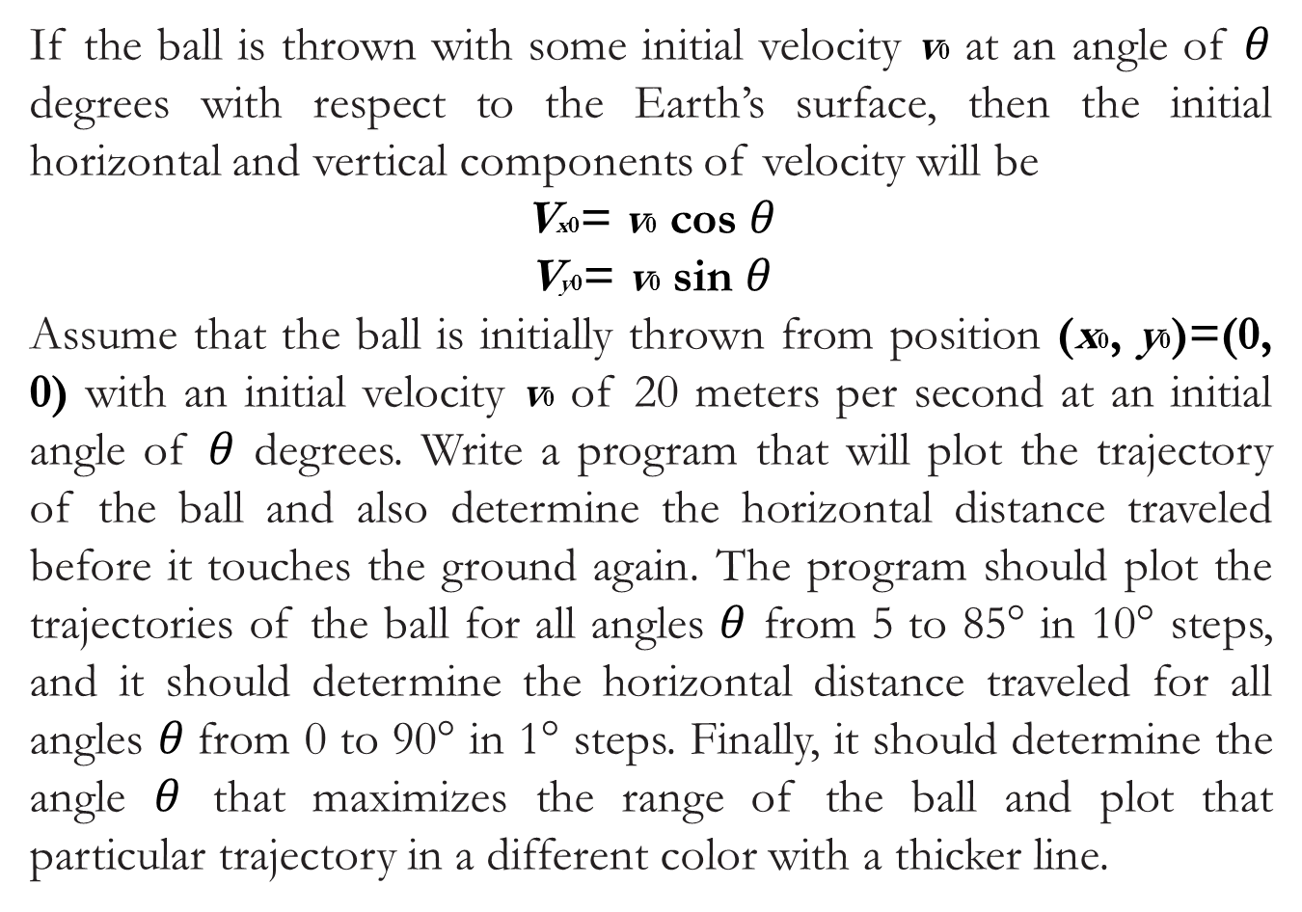
If the ball is thrown with some initial velocity v0 at an angle of $θ$ degrees with respect to the Earth’s surface, then the initial horizontal and vertical components of velocity will be
Vx0= v0 cos $θ$
Vy0= v0 sin $θ$
Assume that the ball is initially thrown from position (x0, y0)=(0, 0) with an initial velocity v0 of 20 meters per second at an initial angle of $θ$ degrees. Write a program that will plot the trajectory of the ball and also determine the horizontal distance traveled before it touches the ground again. The program should plot the trajectories of the ball for all angles $θ$ from 5 to 85° in 10° steps, and it should determine the horizontal distance traveled for all angles $θ$from 0 to 90° in 1° steps. Finally, it should determine the angle $θ$ that maximizes the range of the ball and plot that particular trajectory in a different color with a thicker line.

Slide 43
Hint: we must determine an equation for the time that the ball returns to the ground. Then, we can calculate the (x, y) position of the ball using given equations. If we do this for many times between 0 and the time that the ball returns to the ground, we can use those points to plot the ball’s trajectory.

